Slide 1
AIRBNB Dashboards
Dataset link - https://insideairbnb.com/get-the-data/

Slide 2
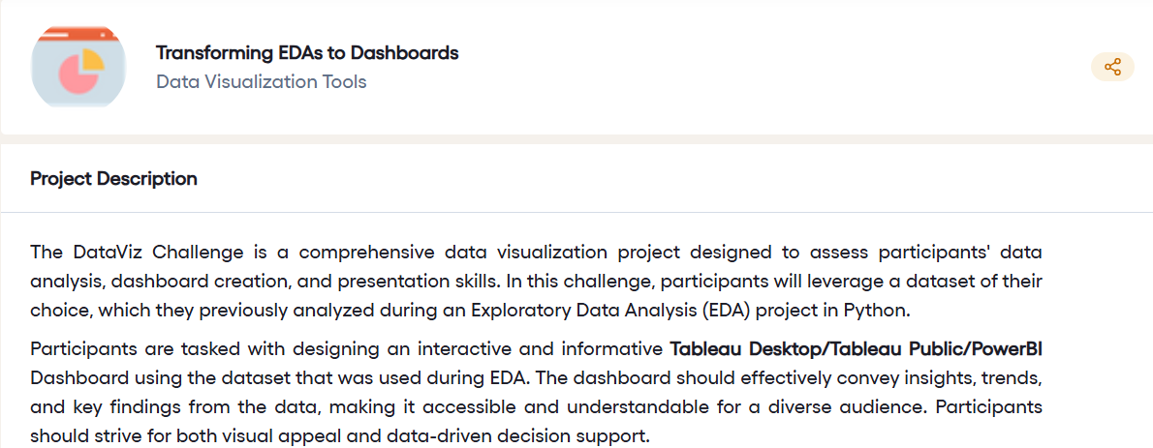

Slide 3
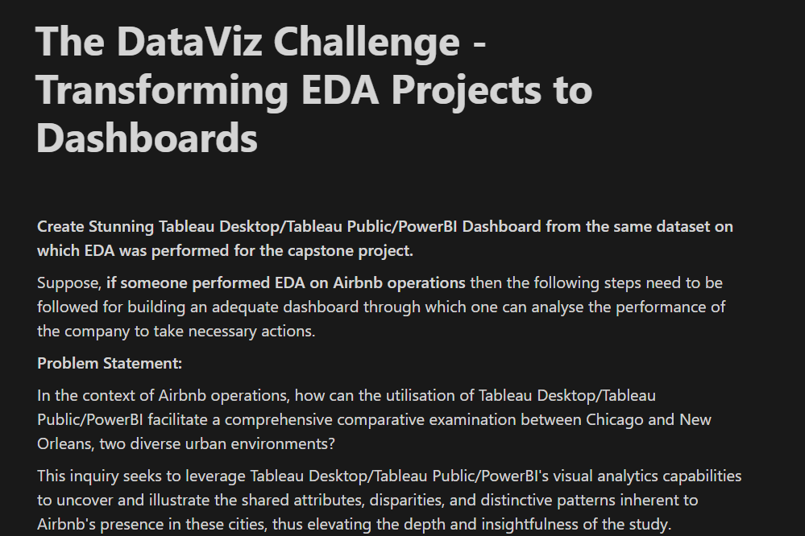

Slide 4
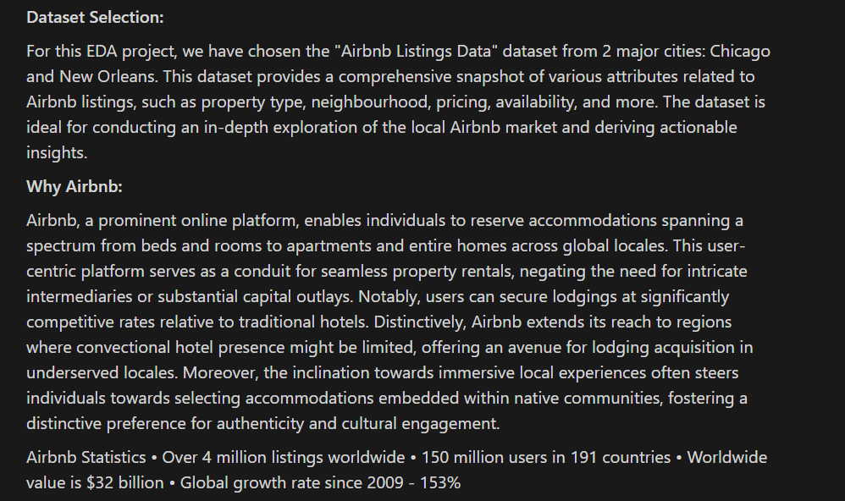

Slide 5
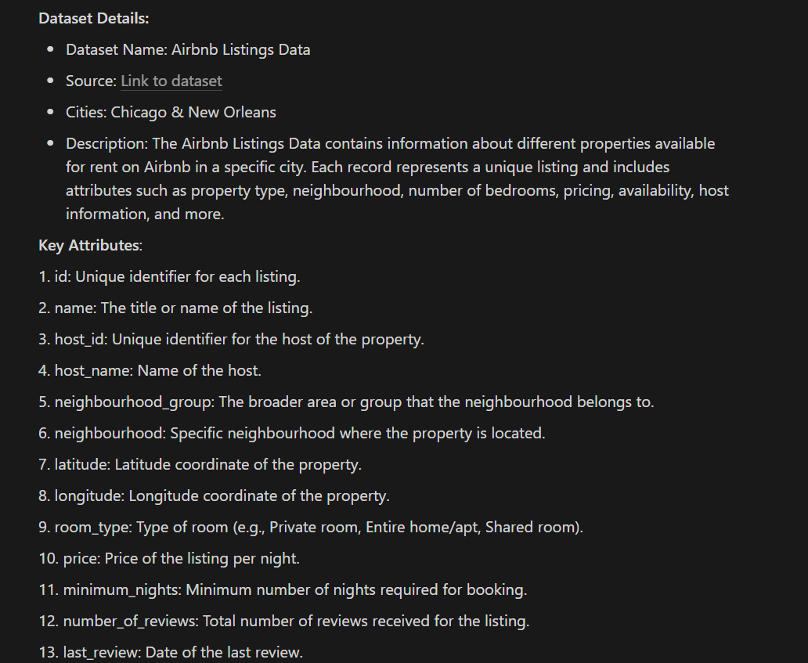

Slide 6
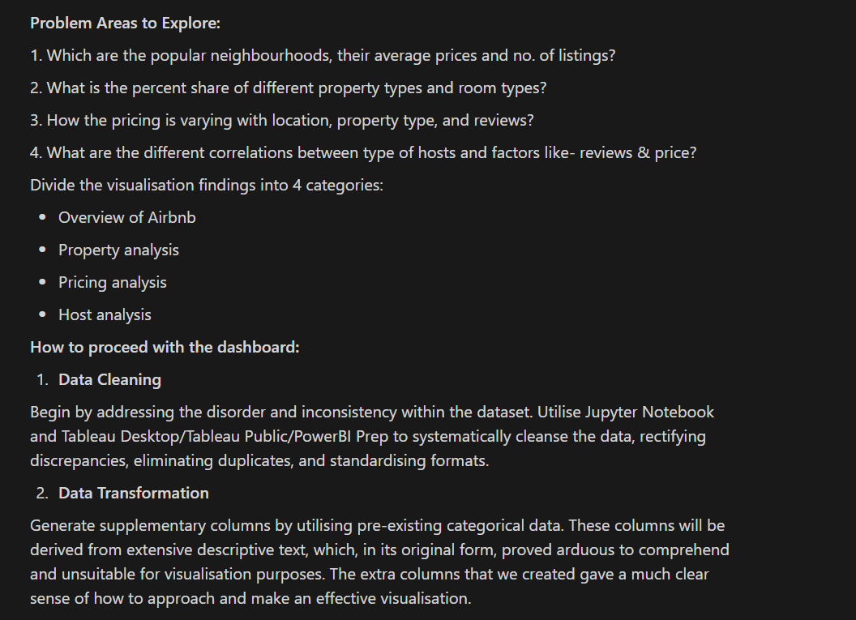

Slide 7
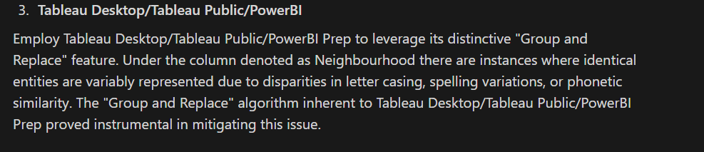

Slide 8
Submission (7days) deadline —> 10th aug
Use any two city data
Create a drive folder, add two files, access to everyone
Dashboard (powerbi, tableau)
Record a video (video length > 7mins, max 20,30mins) → obs studio, loom,zoom
Email → 9th aug → google form → submit → add a link

